Slide 1
Cross Validation
And Clustering with Scikitlearn
CENG 499 Recitation 2

Slide 2
Outline
ML Model Tuning and Evaluation
Cross Validation
Cross Validation with Scikitlearn
Clustering with Scikitlearn
KMeans, Kmeans++, Kmedoids
Hierarchical Agglomerative Clustering
Other methods
Probability Density Estimation
Determining the Number of Clusters/Clustering Evaluation
Elbow Method
Silhouette Method
Manual Inspection (via dimensionality reduction)
Some Critical Points
Data Preprocessing
Hyperparameter Tuning

Slide 3
Model Evaluation and Tuning
Model Evaluation:
Measuring expected future generalization performance (with unseen data).
Model Tuning:
Methods contain hyperparameters that define their behavior.
Tweaking these hyperparameters to obtain the best performance.
When there is abundant data to form the three datasets:
Training dataset: To learn model parameters
Validation dataset: To tune hyperparameters
Test dataset: To evaluate the performance

Slide 4
Model Evaluation and Tuning
When data is scarce to form a separate validation dataset:
A validation dataset reduces the data amount for training.
If there is not sufficient data for training, a model cannot generalize well.
Its training dataset distribution does not represent that of the actual data generation process.
Similar arguments are valid for testing.
Due to a validation dataset, the amount of data for evaluation reduces.
With a small test dataset, generalization performance cannot be measured reliably.
Typical training-validation-test split: 60% (training), 20%(validation), 20%(test).
Without validation dataset, typical split: 70% (training), 30% (test).
How to tune a model without a validation dataset: cross-validation
K-fold cross-validation
Typically 5-fold, 10-fold.

Slide 5

K-Fold Cross Validation (training and test data available)
Image source: https://scikit-learn.org/stable/modules/cross_validation.html

Slide 6
K-Fold Cross Validation (training and test data available)
Some pitfalls (due to training data):
A single run of cross-validation depends on a single partitioning.
Multiple runs by shuffling the training data and averaging
Folds may not contain classes proportionally: class imbalance problem
Forming partitions by considering class distributions: stratification
Some pitfalls (due to test data):
If the original dataset is split into training and test randomly, a single evaluation may depend on this splitting. For a more reliable evaluation:
We can shuffle the whole data and apply the whole K-fold cross-validation procedure from scratch.
We can repeat this multiple times.
It is too costly !!!!.
Instead of random splitting (we can introduce class imbalance problem), we can consider Nested Cross Validation.

Slide 7
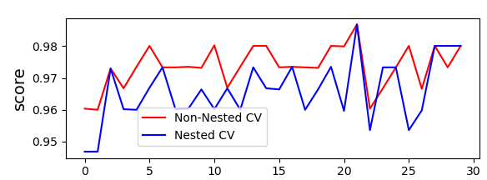
K-Fold Cross Validation (only training data available)
When a testing set cannot be afforded:
We have to perform model tuning and evaluation on the same dataset.
When cross-validation is applied on a dataset without test data:
Unintentionally bias is introduced:
Both best hyperparameters are determined and evaluated.
Overfitting is introduced.
Evaluation results are optimistic.
Solution:
Nested Cross Validation
Image source: https://scikit-learn.org/stable/auto_examples/model_selection/plot_nested_cross_validation_iris.html

Slide 8
Cross Validation with Sklearn
sklearn.model_selection.KFold(n_splits=5, *, shuffle=False, random_state=None)
sklearn.model_selection.RepeatedKFold(*, n_splits=5, n_repeats=10, random_state=None)
sklearn.model_selection.StratifiedKFold(n_splits=5, *, shuffle=False, random_state=None)
sklearn.model_selection.RepeatedStratifiedKFold(*, n_splits=5, n_repeats=10, random_state=None)

Slide 9
Clustering with Scikitlearn

Slide 10
Methods
Kmeans
Kmeans++
Kmedoids
Agglomerative Clustering
Others:
Gaussian Mixture Models
DBSCAN
Spectral Clustering

Slide 11

Kmeans
sklearn.cluster.KMeans(n_clusters=8, *, init='random', n_init=10, max_iter=300, tol=0.0001, verbose=0, random_state=None, copy_x=True, algorithm='lloyd')
The ‘.fit()’ function executes Kmeans on a given dataset.
The ‘.predict()’ function returns cluster label/s for given data sample/s.
After fitting, the attributes:
‘.cluster_centers_’: stores cluster centroids.
‘.labels_’: stores cluster labels for each data instance.
‘.inertia_’: stores the final loss value for the clustering.

Slide 12
Kmeans++
sklearn.cluster.KMeans(n_clusters=8, *, init=k-means++, n_init=10, max_iter=300, tol=0.0001, verbose=0, random_state=None, copy_x=True, algorithm='lloyd')
The ‘.fit()’ function executes Kmeans on a given dataset.
The ‘.predict()’ function returns cluster label/s for given data sample/s.
After fitting, the attributes:
‘.cluster_centers_’: stores cluster centroids.
‘.labels_’: stores cluster labels for each data instance.
‘.inertia_’: stores the final loss value for the clustering.

Slide 13

Kmedoids (sklearn_extra package)
sklearn_extra.cluster.KMedoids(n_clusters=8, metric='euclidean', method='alternate', init='heuristic', max_iter=300, random_state=None)
Some other distance metrics to consider: ‘cosine’, ‘mahalanobis’, and ‘minkowksi’
The ‘.fit()’ function executes Kmeans on a given dataset.
The ‘.predict()’ function returns cluster label/s for given data sample/s.
After fitting, the attributes:
‘.cluster_centers_’: stores cluster centroids.
‘.labels_’: stores cluster labels for each data instance.
‘.inertia_’: stores the final loss value for the clustering.

Slide 14
Agglomerative Clustering
sklearn.cluster.AgglomerativeClustering(n_clusters=2, *, affinity='euclidean', memory=None, connectivity=None, compute_full_tree='auto', linkage='ward', distance_threshold=None, compute_distances=False)
The ‘.fit()’ function constructs a clustering tree (dendrogram).
A ‘.predict()’ function is not provided.
After fitting:
‘.labels_’: stores cluster labels of instances.
‘.children_’: stores the tree structure.
‘.distance_’: provides the distance between nodes in the tree (merge distances).
Code examples…

Slide 15
A Related Topic to Clustering:
Probability Density Function Estimation

Slide 16
Probability Distribution Estimation
There are basically two approaches to estimate probability distribution of data instances:
Parametric [1]
Assumes that the data instances follow a parametric distribution formulation
Such as Gaussian, Gaussian Mixture Models, Beta, Student’s T-distribution, .etc.)
Non-parametric [2,3]
Does not impose any structure on the data, and tries to estimate the distribution function by considering local relations (i.e. distance/similarities).
Knn, Parzen Window, .etc.
Non-parametric approaches require too many instances to be accurate.
In this recitation, we only consider parametric approaches.
[1]: Introduction to Machine Learning, 2nd edition, Ethem Alpaydın, Chapter 4.
[2]: Introduction to Machine Learning, 2nd edition, Ethem Alpaydın, Chapter 8.
[3]: Richard O. Duda, Peter E. Hart, and David G. Stork.
Pattern Classification (2nd Edition) Chapter 4.

Slide 17
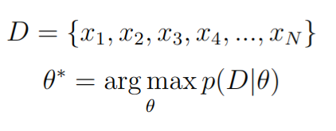
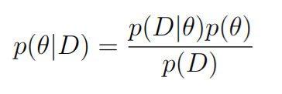
Probability Distribution Estimation
Parametric:
Frequentist View:
Parameters are fixed (no uncertainty).
Maximum likelihood estimation.
Bayesian View:
It treats parameter as a random variable.
Uncertainty is introduced on parameters.
Some parameter values may be more likely.
It is regulated via the prior distribution over the parameter.

Slide 18



Probability Distributions (Gaussian Distribution)
The random variable can take continuous values (i.e. real number):
When the random variable consists of multiple random variables (i.e. data instances are high dimensional):
[1]: Introduction to Machine Learning, 2nd edition, Ethem Alpaydın, Chapter 4.

Slide 19
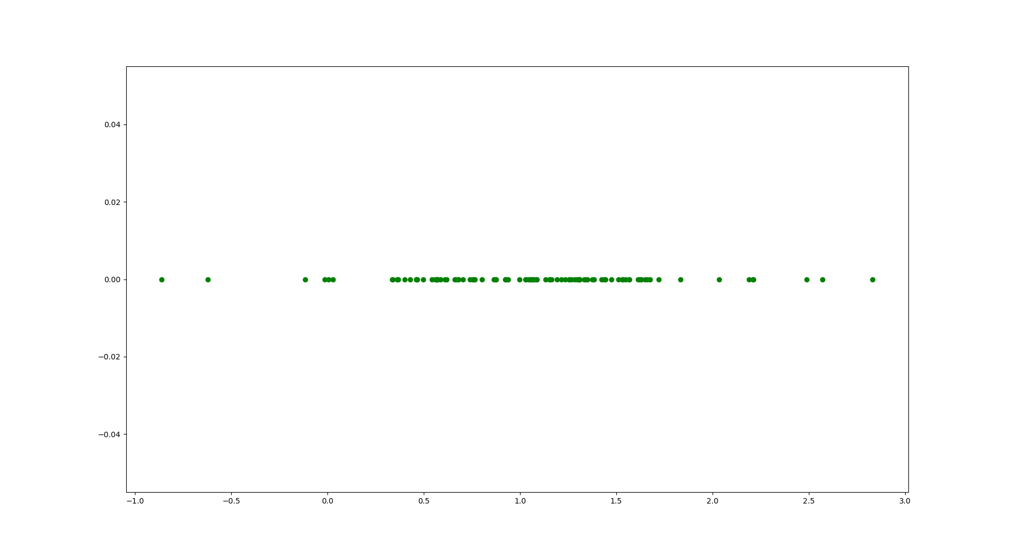
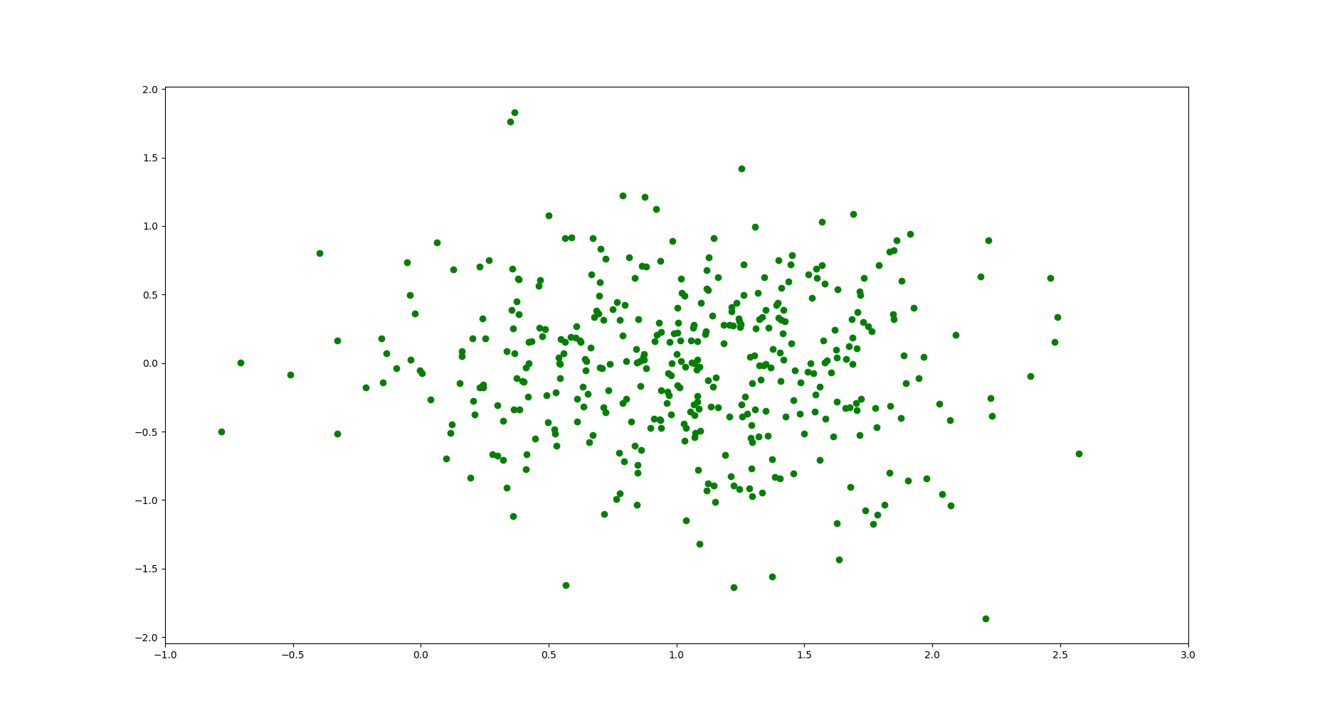
Probability Distributions (Gaussian Distribution)
[1]: Introduction to Machine Learning, 2nd edition, Ethem Alpaydın, Chapter 4.

Slide 20
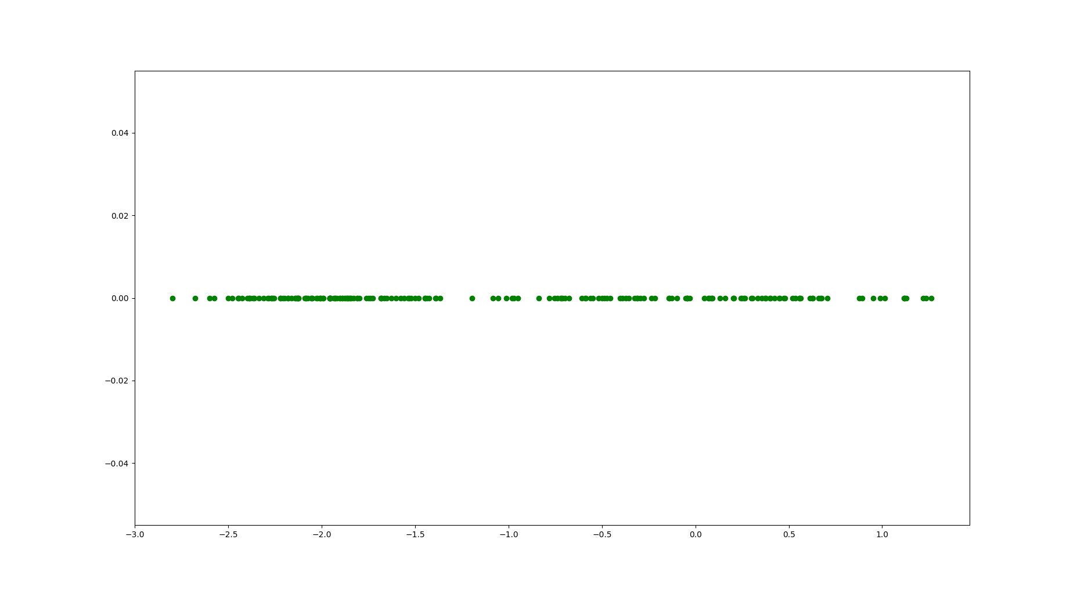
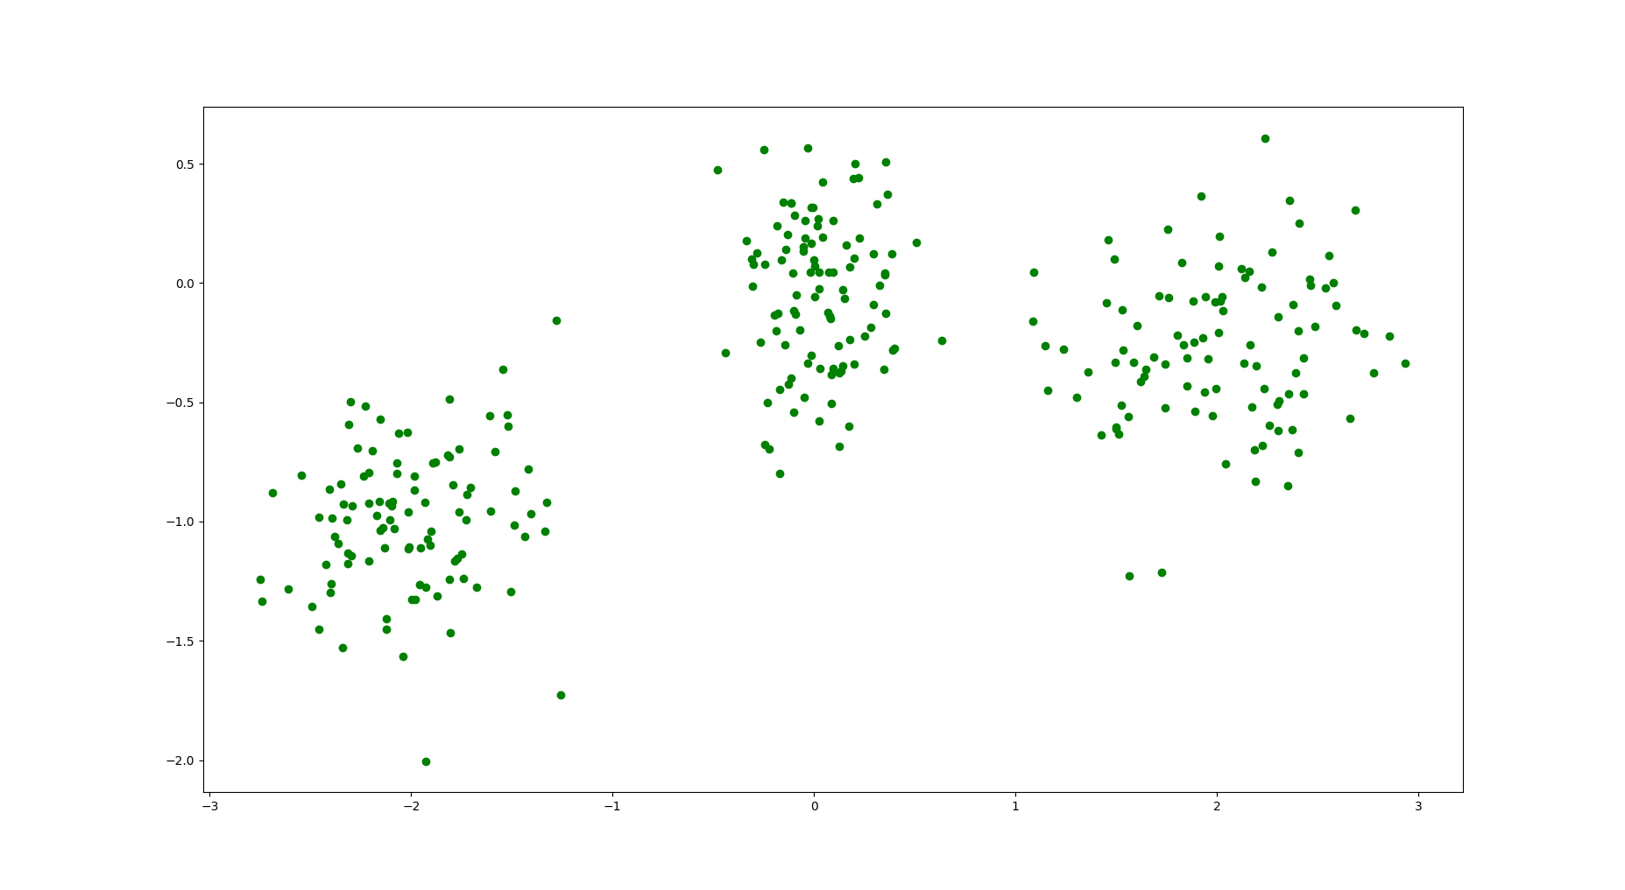
Probability Distributions (Gaussian Mixture Model)
What if the data instances of a particular category are dispersed across the data instance space: A single Gaussian distribution fails to model.

Slide 21
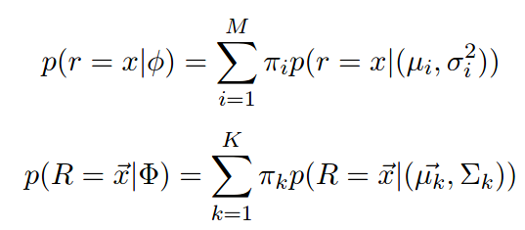

Probability Distributions (Gaussian Mixture Model)
The model consists of multiple Gaussian distributions. It is a linear combination of multiple Gaussian distributions.
Each Gaussian distribution is coined as a component and each π_{i}s and π_{k}s are coined as the mixing coefficients.

Slide 22
Probability Distributions (Gaussian Mixture Model)
Each mixing coefficient determines how much a component contributes to the probability score (likelihood) for a given data instance.
Any data distribution with enough Gaussian components can be approximated with this model.[1]
How many components there should be has to be considered a hyperparameter for the model.
Can be used for clustering tasks as well.
Data instance-cluster relation is expressed via a probability score.
Soft labeling (probabilistic labeling)
[1]: Pattern Recognition and Machine Learning, Christopher M. Bishop, Chapter 2.

Slide 23
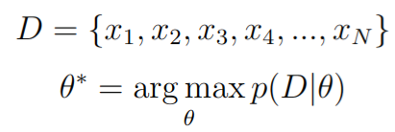
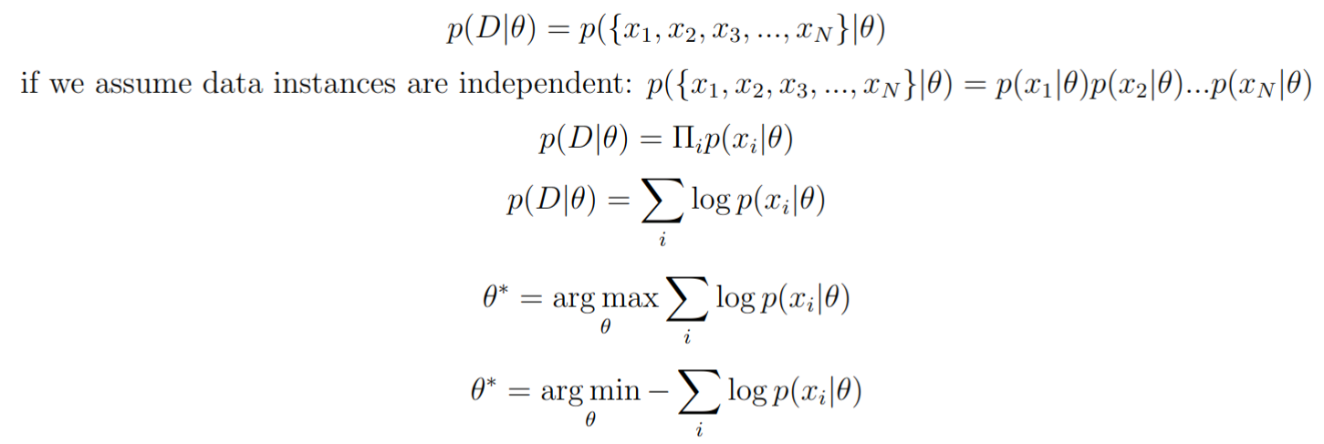
MLE and KL Divergence Relation
[1]: Pattern Recognition and Machine Learning, Christopher M. Bishop, Chapter 1.

Slide 24


MLE and KL Divergence Relation
Kullback-Leibler divergence (KL(p||q)) is a dissimilarity measure between two distributions p and q (defined over the same random variable), and it is defined as follows [1]:
Let’s assume that we have data instances of a particular category/cluster C_{i} and they are generated by an unknown distribution p. If we try to approximate p via a parametric distribution q (q(|Ө^{Ci})) KL divergence becomes [1]:
[1]: Pattern Recognition and Machine Learning, Christopher M. Bishop, Chapter 1.

Slide 25


MLE and KL Divergence Relation
The integral operation considers the whole data instance space but we have a finite number of data instances so the previous KL divergence can be approximated via [1]:
Since (1/N) is a coefficient and the rightmost term does not depend on the parameter Ө, they can be omitted to obtain the minimum KL divergence we need to find the parameter Ө that minimized this term:
[1]: Pattern Recognition and Machine Learning, Christopher M. Bishop, Chapter 1.

Slide 26

MLE and KL Divergence Relation
Equivalently this formulation can be re-written as (-log has been omitted it becomes a maximization problem):
The formulation aims to find the parameter that maximizes the likelihood of all data instances (Maximum likelihood estimation).
So maximum likelihood estimation minimizes the KL divergence between the unknown distribution p and the parametric function q. (minimizes the dissimilarity between the distributions) [1].
[1]: Pattern Recognition and Machine Learning, Christopher M. Bishop, Chapter 1.

Slide 27
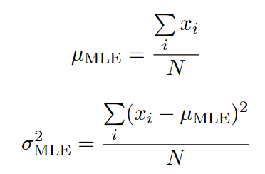
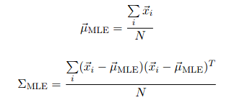
MLE of Gaussian Distribution
The MLE estimates for the hyperparameters of a Gaussian function are [1]:
Basically, the sample mean and sample variance/covariance.
[1]: Introduction to Machine Learning, 2nd edition, Ethem Alpaydın, Chapter 4.

Slide 28
Gaussian MLE Example

Slide 29
MLE of Gaussian Mixtures Model
Unfortunately, there is no analytical solution unlike Gaussian and Categorical distributions [1].
To be able to perform the MLE operation, the expectation maximization (EM) technique is used.
[1]: Richard O. Duda, Peter E. Hart, and David G. Stork. 2000. Pattern Classification (2nd Edition) Chapter 10.

Slide 30
Expectation Maximization Technique
By introducing hidden variables, it aims to perform maximum likelihood estimation [1].
First, it initializes the parameters (to be maximized) and then executes its expectation-maximization loop:
In the E step, it calculates values for the hidden variables,
In the M step, it recalculates the parameter values with the hidden variable values calculated in the E step.
In each EM step, the likelihood function increases monotonically.
But it can easily get stuck in a local optimum (maxima).
[1]: Introduction to Machine Learning, 2nd edition, Ethem Alpaydın, Chapter 7.

Slide 31
Gaussian Mixture Model Training with Scikitlearn
sklearn.mixture.GaussianMixture(n_components=1, *, covariance_type='full', tol=0.001, reg_covar=1e-06, max_iter=100, n_init=1, init_params='kmeans', weights_init=None, means_init=None, precisions_init=None, random_state=None, warm_start=False, verbose=0, verbose_interval=10)
The ‘.means_’ attribute stores the Gaussian mean vectors.
The ‘.covariances_’ attribute stores the covariance matrices.
The ‘.weights_’ attribute stores the mixing coefficient.
It provides fit, predict, sample, and score functions.

Slide 32
GMM MLE Example

Slide 33
Determining Number of Clusters/
Clustering Evaluation

Slide 34
Methods
Elbow Method
Silhouette Method
Manual Inspection
Dimensionality Reduction

Slide 35
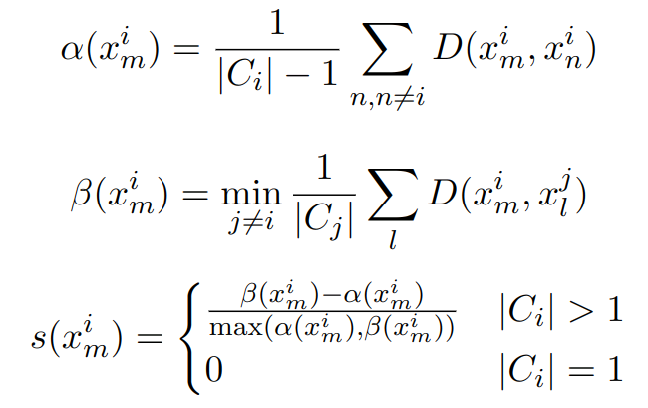

Silhouette Method
The silhouette value can be used to assess the quality of clustering and determine the number of clusters.
For each data instance, this score is calculated.
The score ranges from -1 to 1.
1 indicates the data point is clustered well.
-1 indicates the data point is not clustered as desired.
Average silhouette value can give an idea about an overall clustering result.

Slide 36
Silhouette Method (with Scikitlearn)
To calculate individual silhouette instance scores:
sklearn.metrics.silhouette_samples(X, labels, *, metric='euclidean', **kwds)
To calculate the average silhouette value:
sklearn.metrics.silhouette_score(X, labels, *, metric='euclidean', sample_size=None, random_state=None, **kwds)
The silhouette method can be used with any clustering method that provides cluster labels of data points.

Slide 37
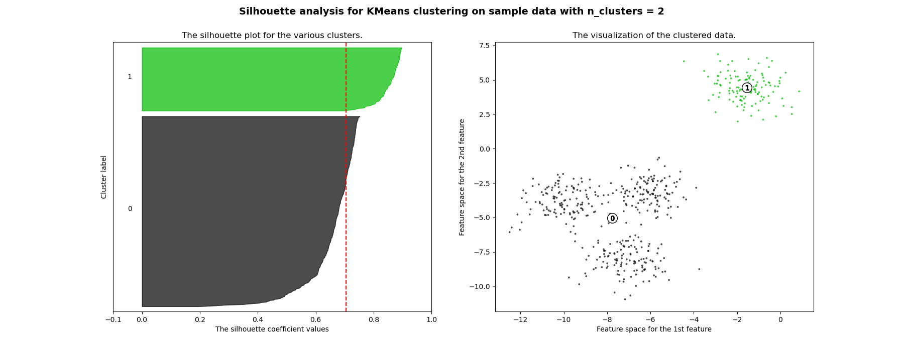
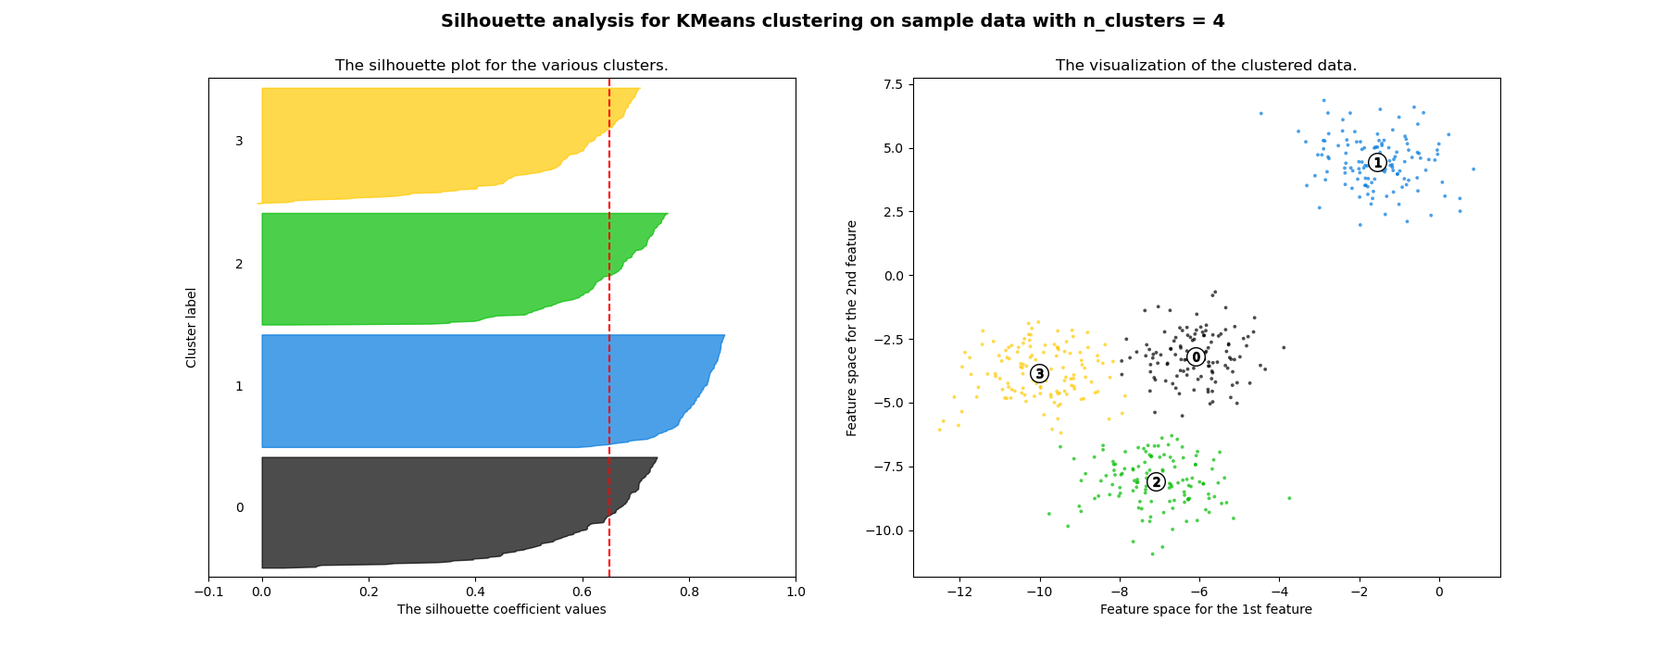
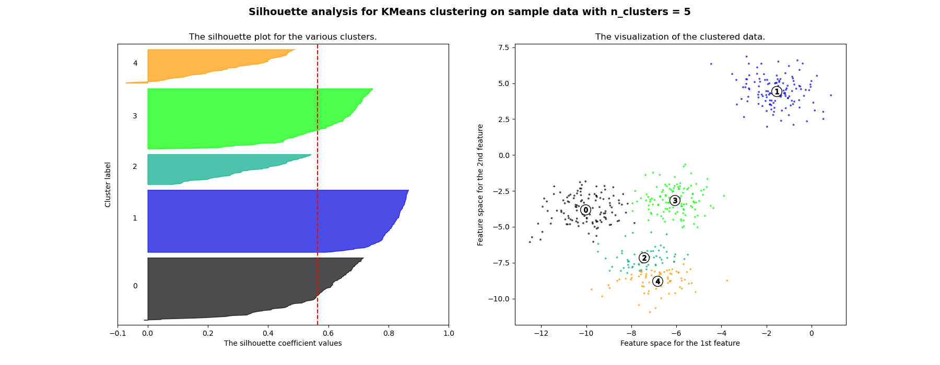
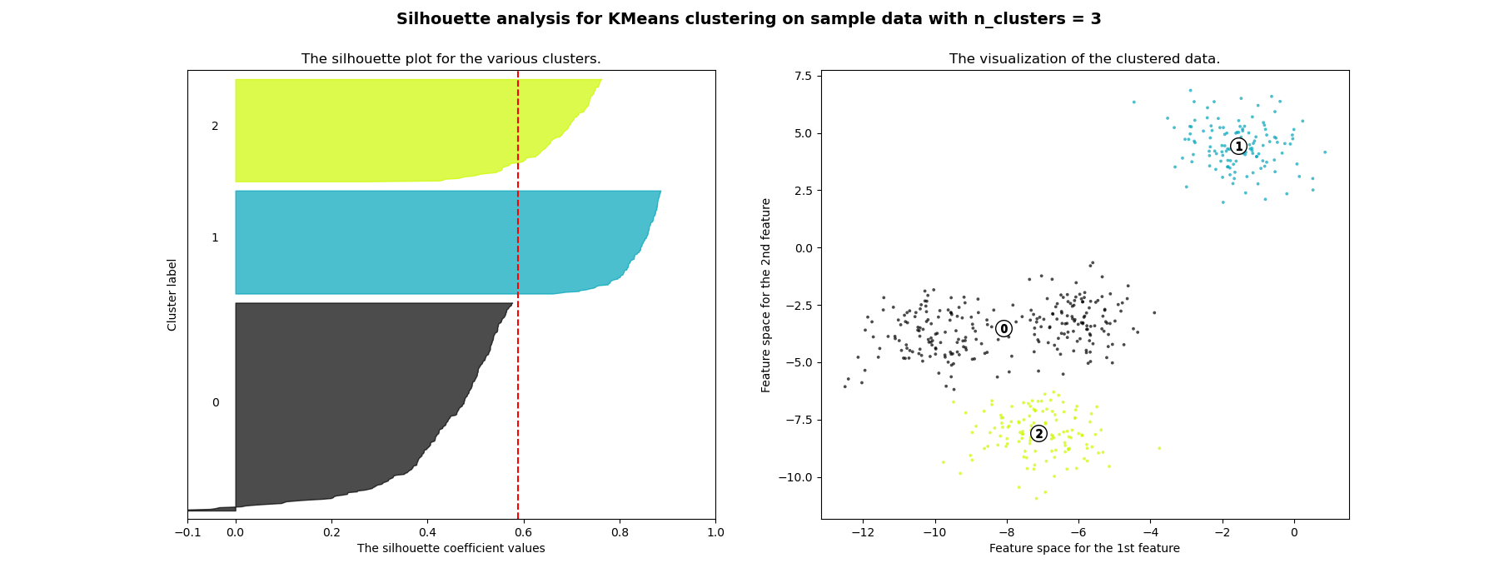
Silhouette Method (Example Analysis)
Image Source: https://scikit-learn.org/stable/auto_examples/cluster/plot_kmeans_silhouette_analysis.html#sphx-glr-auto-examples-cluster-plot-kmeans-silhouette-analysis-py

Slide 38
Manual Inspection
We can transform/map data instances into 1-D, 2-D, 3-D and visualize them.
To this end dimensionality reduction methods can be employed.
In this recitation, we utilize the Principle Component Analysis (PCA), T-distributed Stochastic Neighbor Embedding methods (tSNE) and UMAP.

Slide 39
Dimensionality Reduction (Scikitlearn, umap-learn)
PCA [1]:
sklearn.decomposition.PCA(n_components=None, *, copy=True, whiten=False, svd_solver='auto', tol=0.0, iterated_power='auto', n_oversamples=10, power_iteration_normalizer='auto', random_state=None)
t-SNE [2]:
sklearn.manifold.TSNE(n_components=2, *, perplexity=30.0, early_exaggeration=12.0, learning_rate='auto', n_iter=1000, n_iter_without_progress=300, min_grad_norm=1e-07, metric='euclidean', metric_params=None, init='pca', verbose=0, random_state=None, method='barnes_hut', angle=0.5, n_jobs=None)
UMAP [3]:
UMAP(learning_rate=1.0, local_connectivity=1.0,metric='euclidean', metric_kwds=None, min_dist=0.1, n_components=2, n_epochs=None, n_neighbors=15, output_metric='euclidean', output_metric_kwds=None, random_state=42, verbose=False)
[1]: https://scikit-learn.org/stable/modules/generated/sklearn.decomposition.PCA.html
[2]: https://scikit-learn.org/stable/modules/generated/sklearn.manifold.TSNE.html
[3]: https://umap-learn.readthedocs.io/en/latest/parameters.html

Slide 40
Dimensionality Reduction Examples

Slide 41
Some Critical Points for Clustering

Slide 42
Critical Points
Data Preprocessing
It is a very crucial step before employing any ML method. Some methods require data points to have a particular data distribution.
Example
Hyperparameter Tuning
All clustering methods have different types of parameters.
If possible all hyperparameter values should be tested via Grid-search in order to find the best hyperparameter configuration.

Slide 43
After Clustering

Slide 44
After Clustering
After data instances are clustered, if we are given a class label for a single point in each cluster, we can label all cluster members.
Labeling is a costly operation.
With a single label, other data instances can be labelled.
By inspecting data instances in a cluster, we can elicit information about the cluster, which may useful for problems such as:
Detecting communities:
In a forum websites, users can form communities depending on which topics they are active.
Recommendation:
Users who buy similar items can be grouped together and new items can be recommended to the group members.
In a bank application, users can form clusters depending on their financial status and activities. Banks can offer different financial investment plan for different groups.

Slide 45
Thanks for Listening and for Your Time

